Slide 1
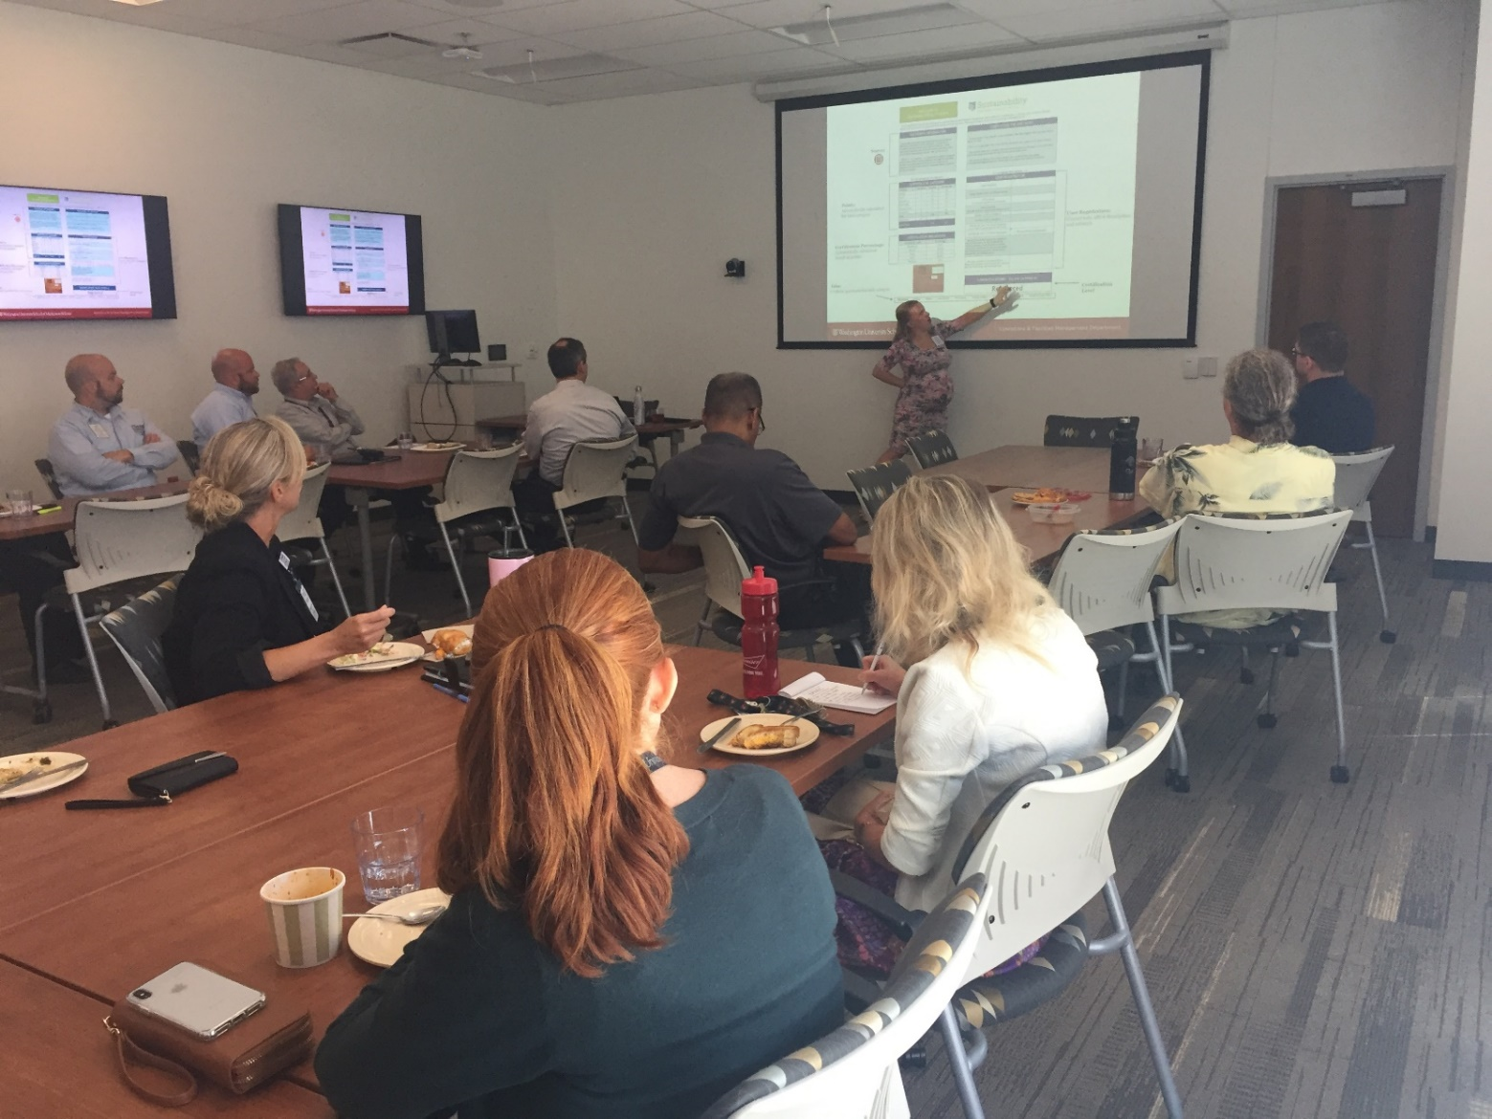
The Green Office Program
Resource Guide

Slide 2
Overview
E4: Power Mode
E5: Printers & Copiers
E7: Space Heaters
W1: Community Trash
W4: Recycling Review
D6: Unwanted Subscriptions
P6: Styrofoam Products
P11: Bottled Water
P12: Green Catering
T1: Alternative Transportation
T3: U-Pass
T7: Buses
T7: Bikes
T7: Bearly Drivers Program
T9: Enterprise Car Share
A2: New Offices
A3: Sustainability Pledge
A5: Green Monday Pledge
A10: Office Goals
Green Office Survey
Notes:
These are the different categories that are covered within the checklist. By presenting this checklist to your office you can officially add W4, T7, and A10 to your checklist. Additionally, by having a conversation about the rest of these categories you can create awareness and work with your team to achieve these other goals.

Slide 3
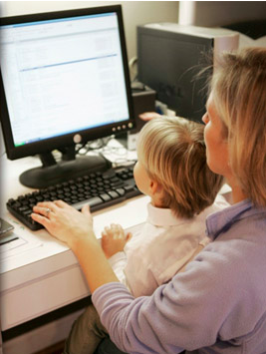
E4: Power Mode
Enabling power mode reduces electricity costs and fossil fuel use
Although your monitor may be on sleep mode when the computer is inactive, your computer itself may not
Configure operating system (Windows or Mac OS) to reduce power usage

Slide 4
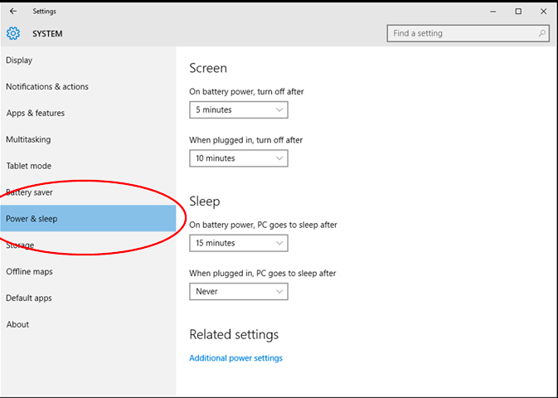
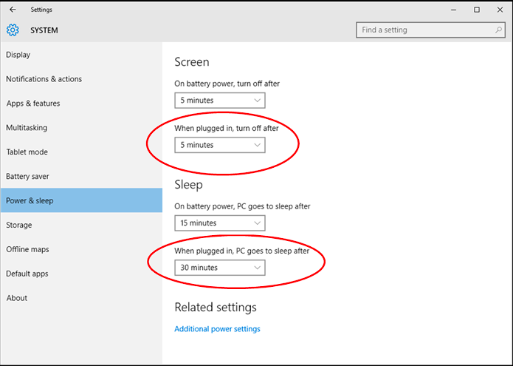
E4: Windows 10
Click on system, power & sleep, and configure so monitor dims after 2 minutes & turns off after 5 minutes; all computers sleep after 15 minutes

Slide 5
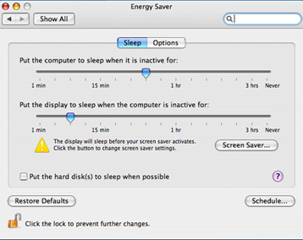
E4: Mac OS
Click on system preferences, energy saver, and configure so monitor dims after 2 minutes & turns off after 5 minutes; all computers sleep after 15 minutes
For more operating systems Windows Vista, 7, & 8, consult a Green Team member or visit www.energystar.gov

Slide 6
E5: Printers & Copiers
Idle mode uses electricity and reduces the life of your printer
Turn off printers & copiers each night and enable sleep mode (office and/or individual printers)
Is there anyone in the office who would volunteer each night? Does the printer have an automatic setting?

Slide 7
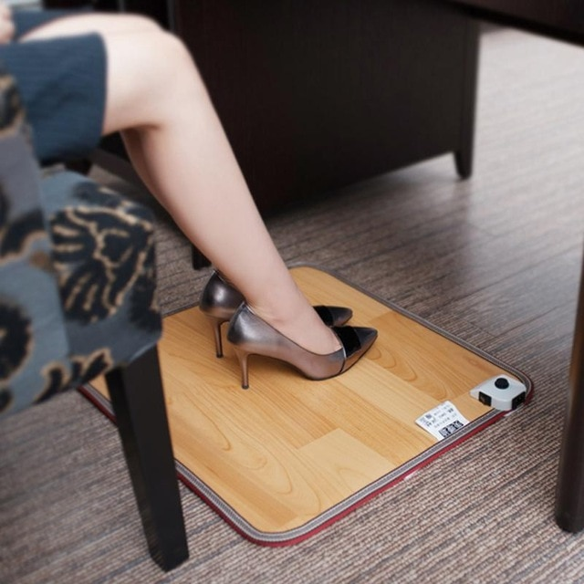
E7: Space Heaters
Space heaters have very high electricity demands and carry increased risk of fire/circuit overload
Footwarmers provide the same benefit and none of the risk. Is there anyone willing to try one through our office?

Slide 8
W1: Community or Hanging Trash Bins
Remove individual bins in favor of community or hanging landfill ones
If you have to get up to throw away your trash, you’re more likely to make a conscious decision when sorting it
Office wide trash bins reduce the use of plastic liners
Reduce custodial costs and boost efficiency
Notes:
Liners: No bin liners will be provided. If individuals would like liners, they must bring their own bags from home. For messy landfill items, office members should use the common area landfill bin, which does have a liner.
Cleaning: Faculty and staff are responsible for emptying hanging bins into the common area receptacle and periodically cleaning the bins themselves, if necessary. Housekeeping will continue to service the individual recycling bins in each office as well as the communal landfill receptacle(s).
Purchasing: In exchange for returning all individual landfill bins, WUSTL Facilities Planning and Management will pay for and deliver the new hanging bins. The old individual bins will be warehoused by Facilities until a use can be found for them.
Enrollment: if you are on Danforth/North/West Campus, to enroll in the program, email Jan Schade at jschade@wustl.edu. If you are located at the Medical Campus, email Steve Smith at smithst@wusm.wustl.edu.

Slide 9
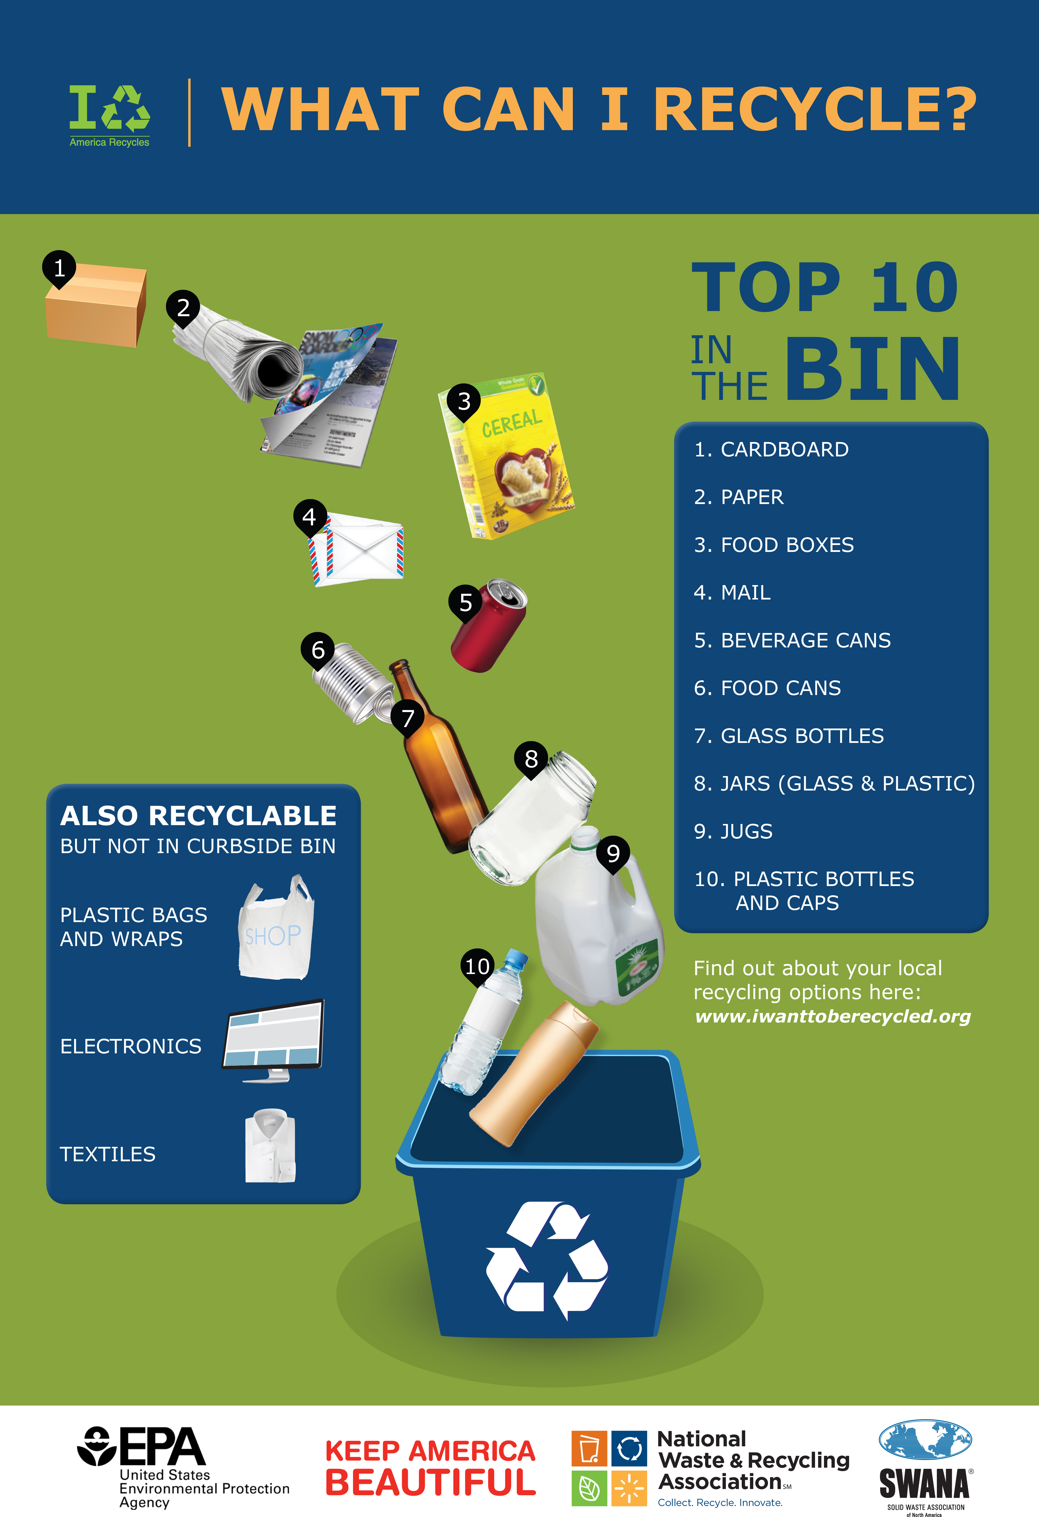
W4: What to Recycle
Make sure to look at the labels on plastic products and recycle #1, #2, #3, #4, and #5 plastics.
Typically, you can recycle...
Paper products
Glass bottles and jars
Metal products, like cans
Cartons and cardboard

Slide 10
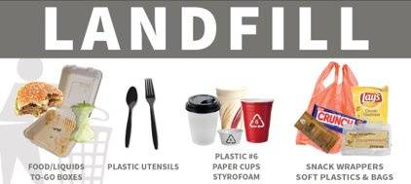
W4: What Not to Recycle
Absolutely no food, liquids, ice, paper cups, to-go bowls/boxes, utensils, Styrofoam, napkins, tissues, or coffee cups and lids should go in.
Some products, like utensils, coffee cups/lids, and to-go bowls/boxes will say they are compostable. If compost is available, compost. If not, landfill.
Notes:
Note: paper cups with waxy interior liners cannot be recycled. Any hot beverage purchased at WashU cannot currently be recycled.

Slide 11
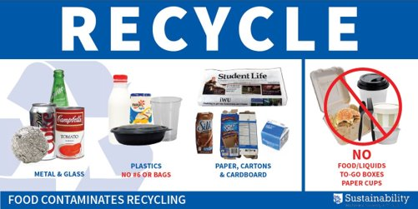
W4: Recycling Check
Avoid wish-cycling! If you're not sure if something can be recycled but think it could be, it is safer to landfill it instead.
In Missouri, #6 plastics are NOT recyclable. Only some #7 plastics are compostable. Make sure to check your labeling on the product for guidance.
If the product has a lot of food residue, make sure to wash it first before recycling. Ideally, materials should be clean and dry.

Slide 12
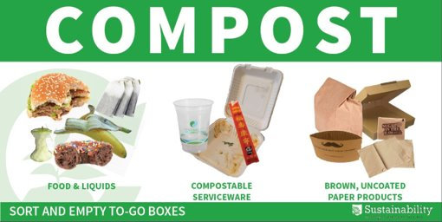
W4: Remember to Compost
Compost foods and liquids, brown paper products, napkins, and paper to-go boxes where compost is available.
Check plastic products to see if they are compostable.
Make sure to take regular utensils out of to-go boxes before composting.

Slide 13
D6: Unwanted Subscriptions
Is anyone receiving catalogs they don’t want?
Reducing junk mail helps the environment, protects your privacy, and limits clutter
Use Catalog Choice to get started; they will send opt-out requests on your behalf, or call and discontinue individually

Slide 14
P6: Styrofoam Products
Styrofoam is the fifth largest source of hazardous waste in the US
Styrofoam is composed of carcinogens, can cause health problems when microwaved, and takes up to 500 years to decompose
When purchasing for your office, please avoid Styrofoam products (cups, bowls, plates, packing peanuts, & coolers)

Slide 15
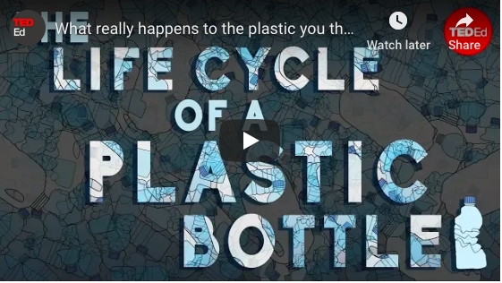
P11: Bottled Water
In the US, we use more than 50 billion plastic water bottles each year
38 billion end up in our landfills, oceans, and streets
Plastic bottles take hundreds of years to biodegrade
Encourage office members to bring their own reusable water bottle.
https://www.youtube.com/watch?time_continue=2&v=_6xlNyWPpB8

Slide 16
P12: Green Catering
For meetings and events with catered food, use a vendor certified with the Green Dining Alliance
Look through the list of reviewed and recommended restaurants and caterers who have demonstrated that they can accommodate requests for zero waste food service.
Use the Green Event Caterer Questionnaire to make sure you are covering all your bases!

Slide 17
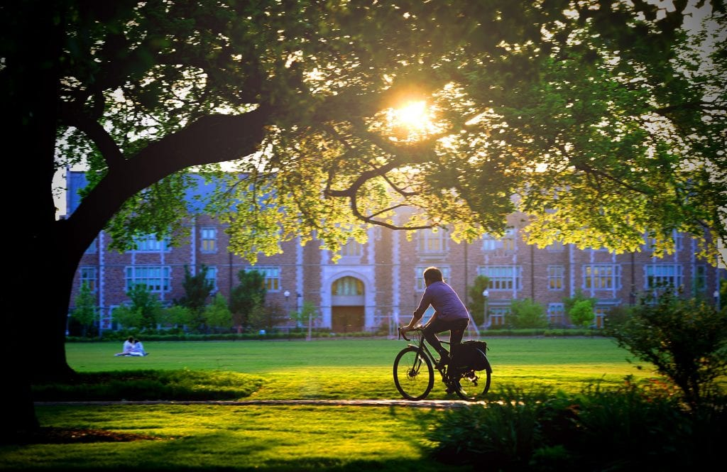
T1: Alternative Transportation
Through education and changes to policies and infrastructure, WashU works to advance low-carbon, active forms of transportation that lessen environmental impact, encourage healthy lifestyles, and strengthen our sense of community.

Slide 18
T7: Bearly Drivers Program
Full-time Danforth faculty and staff who meet all eligibility requirements may share the cost of a parking permit and park in designated Bearly Drivers parking spaces.
More information is available on the Bearly Drivers Carpool page.
Notes:
Encourage office members to arrange carpool systems to work to save time and money.
Coming soon: WashU Rides – a RideSharing program that matches potential carpool passangers/drivers.

Slide 19
T3: U Pass
The U-Pass Program provides free Metro passes to Wash U faculty and staff
If an office member has a U-Pass and uses it once a month, your office will receive a point towards the checklist.
To register for a U-Pass, visit this website. Is anyone willing to sign up now?
Notes:
Those who have a U-Pass are far more likely to use it intermittently than if they don’t have one! Once you get yours, if you are new to public transit, consider trying it to get to another campus or to a weekend excursion.

Slide 20
T7: Buses
With a U-Pass and WashU ID, office members have access to Metro bus lines.
The #1 Gold Line serves the Danforth Campus and the Medical Campus.
The #2 Red Line serves the Danforth Campus, North Campus, the St. Louis Galleria, Brentwood Square and Maplewood Commons.
The Green Line serves the Danforth Campus, Lewis Center, Greenway, the Lofts Apartments, and the Big Bend Metro Station.

Slide 21
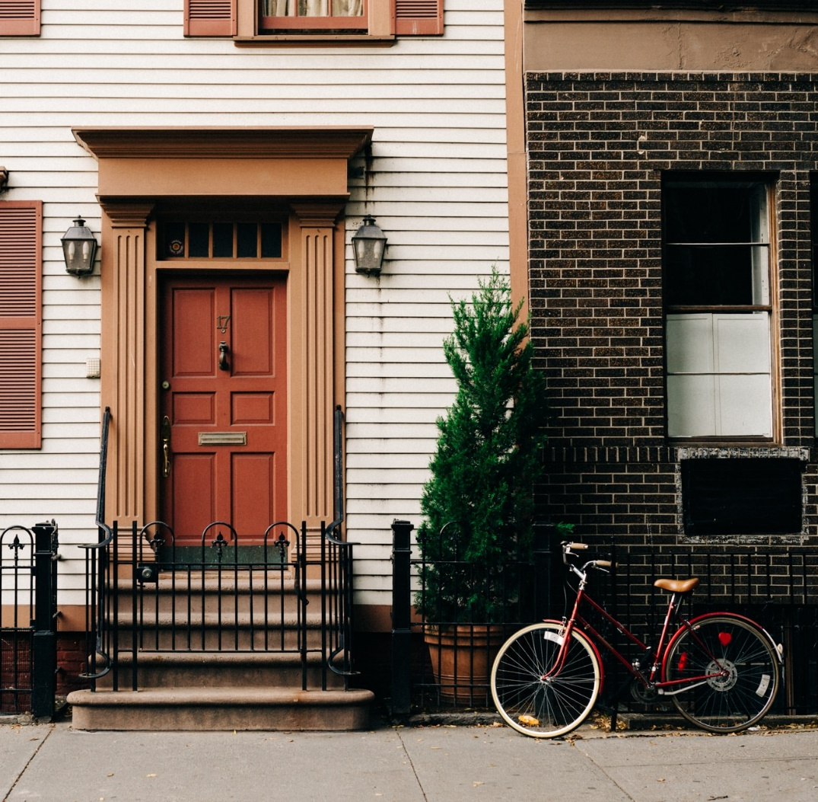
T7: Bikes
Encourage office members to bike to work.
WashU offers a lot of different bike amenities on campus, including...
Fixit Self Tune-Up Stations
Discounted U-Locks and helmets
Rental Bikes at Bears Bikes
East End Bike Hub
For more information, visit WashU's Resources for Bikers Page.
Notes:
**** Look for another photo
Add additional info about the bike hub here

Slide 22
T9: Enterprise Car Share
Enterprise, a car share service, increases convenience and reduces the number of vehicles on the road
Offices that have a Enterprise account for university business receive a point towards the checklist
Would anyone be interested in signing up?

Slide 23
A2: New Offices
Your office will be awarded a point for inviting another office to participate in the Green Office program
Poll: Does anyone have an office they would like to recommend?

Slide 24
A3: Sustainability Pledge
The sustainability pledge is a personal commitment to sustainable living. Take it here.
Taking the pledge will also subscribe you to the Office of Sustainability newsletter, so you can stay up-to-date on sustainability news, events, and jobs at WashU and in the community (and earn you a point on the checklist).

Slide 25
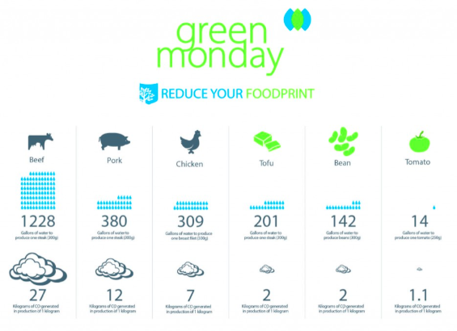
A5: Green Monday Pledge
Our food choices have a major impact on public health and the environment.
The Green Monday Pledge is a commitment to eat vegetarian once a week.

Slide 26
A10: Office Goals
Setting goals leads to better outcomes.
What are some specific goals your office has to improve sustainable operations or policies in the upcoming year?

Slide 27
Green Office Survey
If your office has more than 25 people, we ask that the Green Office Liaison use a survey to collect information about individual practices
75% of the office must fill out the survey
The survey asks about relevant items, which will help the liaison complete the checklist
Contact a Green Team Member for a personalized link
Notes:
Ideally, reach out to get a survey prior to this presentation so you can have your team fill it out at this point in the presentation!

Slide 28
Questions
Thank you!
Are there any more resources your office would like to see?
Contact the Green Team at sustainability@wustl.edu

